Slide 1



TLIQ HARDWARE
AD_HOC INSIGHTS
CHALLENGE : PROVIDE INSIGHTS TO MANAGEMENT IN CONSUMER GOODS DOMAIN
Domain: Consumer Goods
Function: Executive Management
BY
SHREETAMA DASGUPTA
Codebasics Resume Project Challenge

Slide 2
ATLIQ HARDWARE
Atliq Hardware is one of the leading computer hardware producers in India and well expanded in other countries too.

Slide 3
PROBLEM STATEMENT
The management noticed that they do not get enough insights to make quick and smart data-informed decisions. They want to expand their data analytics team by adding several junior data analysts. Tony Sharma, their data analytics director wanted to hire someone who is good at both tech and soft skills. Hence, he decided to conduct a SQL challenge which will help him understand both the skills.

Slide 4
TASK
As an applicant for this role the following task need to be performed. 1. The ‘ad-hoc-requests.pdf’ has to be checked. There are 10 ad hoc requests for which the business needs insights. 2. SQL queries need to be run to answer these requests.

Slide 5
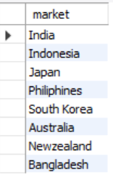
Request-1:
Provide the list of markets in which customer "Atliq Exclusive" operates its business in the APAC region.
SQL Query:
Output:
select distinct market from dim_customer where region="APAC“ and customer="Atliq Exclusive";

Slide 6

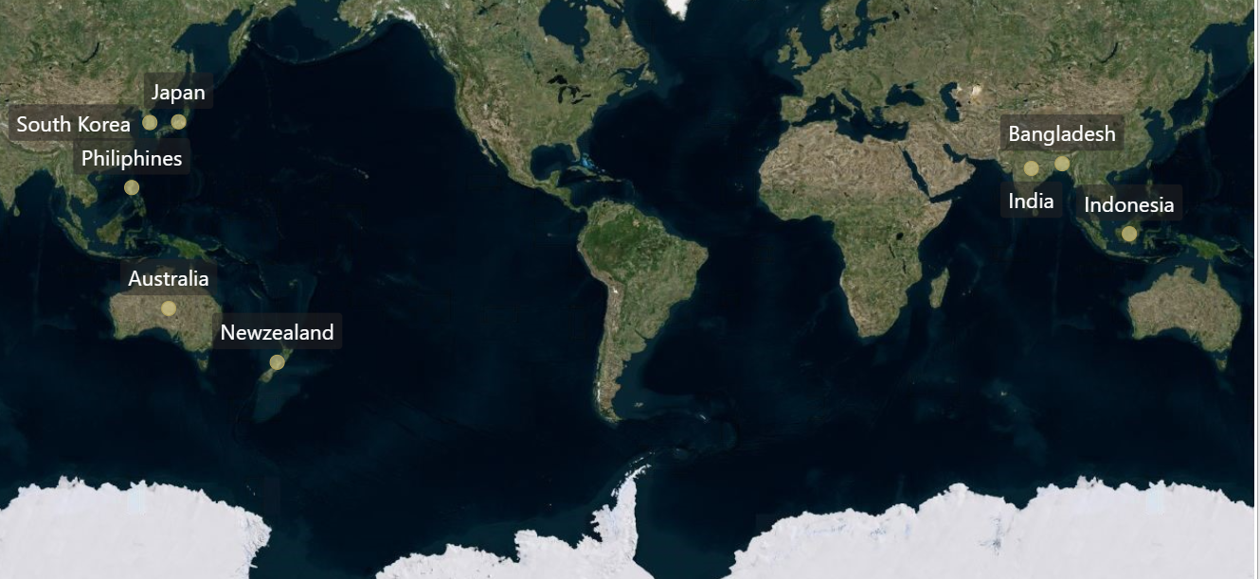
markets in which customer "Atliq Exclusive" operates its business in the APAC region.

Slide 7
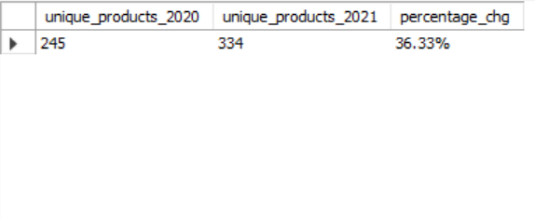
Request-2:
. What is the percentage of unique product increase in 2021 vs. 2020?
SQL Query:
with Unq2020 as
(select count(distinct product_code) as unique_products_2020 from fact_sales_monthly where fiscal_year=2020),
Unq2021 as
(select count(distinct product_code) as unique_products_2021 from fact_sales_monthly where fiscal_year=2021)
select unique_products_2020, unique_products_2021,
concat(round((unique_products_2021-unique_products_2020)/unique_products_2020*100,2), "%") as percentage_chg from Unq2020, Unq2021;
Output:

Slide 8
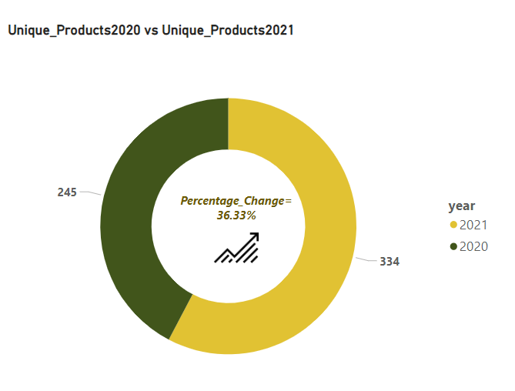
The number of products sold by Atliq Hardware has increased by 36.33% from 2020 to 2021

Slide 9
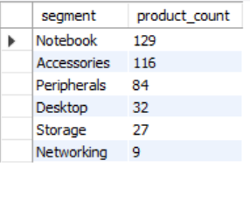
Request-3:
Provide a report with all the unique product counts for each segment and sort them in descending order of product counts.
SQL Query:
select segment, count(distinct product_code) as product_count from dim_product group by segment order by 2 desc;
Output:

Slide 10
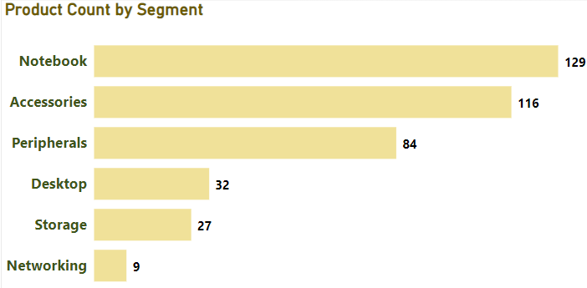
Atliq Hardware has comparatively more varieties in the segments ‘Notebook’ and ‘Accessories’.

Slide 11
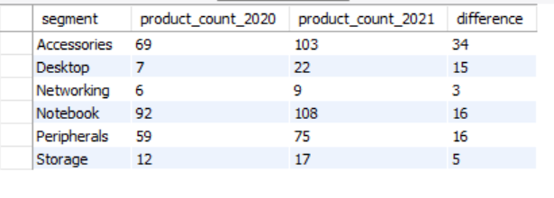
Request-4:
Follow-up: Which segment had the most increase in unique products in2021 vs 2020?
SQL Query:
with Product_Count as
(select segment,
count(distinct(case when fiscal_year = 2020 then product_code end)) as product_count_2020,
count(distinct(case when fiscal_year=2021
then product_code end)) as product_count_2021
from dim_product inner join fact_sales_monthly using(product_code)
group by segment)
select segment, product_count_2020,product_count_2021, (product_count_2021-product_count_2020) as difference
from Product_Count;
Output:

Slide 12
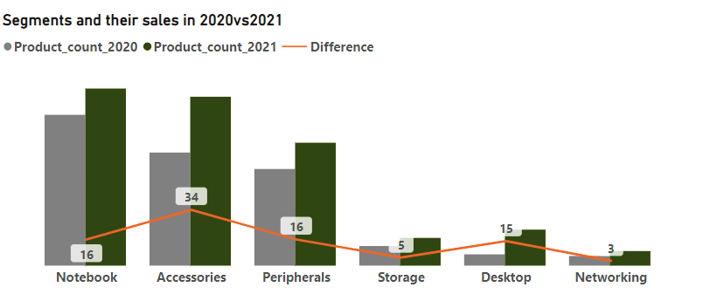
The segment “Accessories” had the maximum increase in product quantity.

Slide 13
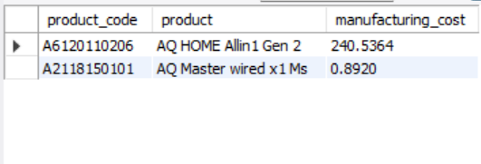
Request-5:
Get the products that have the highest and lowest manufacturing costs.
SQL Query:
select product_code, product, manufacturing_cost
from fact_manufacturing_cost inner join dim_product using(product_code)
where manufacturing_cost in
(select max(manufacturing_cost) from fact_manufacturing_cost)
Union
select product_code, product, manufacturing_cost
from fact_manufacturing_cost inner join dim_product using(product_code)
where manufacturing_cost in
(select min(manufacturing_cost) from fact_manufacturing_cost);
Output:

Slide 14

AQ HOME Allin1 Gen 2 has the highest manufacturing cost while AQ Master wired x1 Mshas the lowest manufacturing cost.
AQ HOME Allin1 Gen 2
AQ Master wired x1 Ms

Slide 15
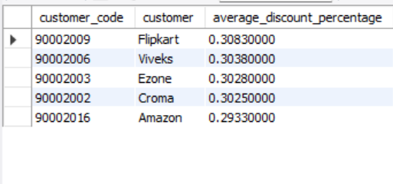
Request-6:
Generate a report which contains the top 5 customers who received an average high pre_invoice_discount_pct for the fiscal year 2021 and in the Indian market.
SQL Query:
select customer_code, customer,
avg(pre_invoice_discount_pct) as average_discount_percentage
from fact_pre_invoice_deductions
inner join
dim_customer
using(customer_code)
where fiscal_year=2021 and market="India“
group by customer_code
order by average_discount_percentage desc
limit 5;
Output:

Slide 16
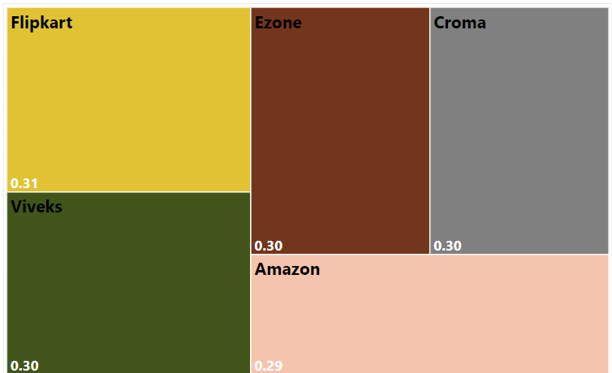

Top 5 customers who received an average high pre_invoice_discount_pct for the fiscal year 2021 and in the Indian market.

Slide 17
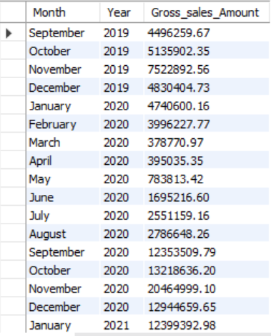
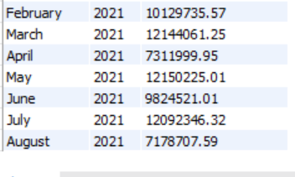
Request-7:
Get the complete report of the Gross sales amount for the customer “AtliqExclusive” for each month. This analysis helps to get an idea of low and high-performing months and take strategic decisions.
SQL Query:
Output:
select monthname(date) as Month ,year(date) as Year,
round(sum(sold_quantity*gross_price),2) as Gross_sales_Amount
from fact_sales_monthly
inner join fact_gross_price using(product_code,fiscal_year)
inner join
dim_customer
on fact_sales_monthly.customer_code=
dim_customer.customer_code
where customer= "Atliq Exclusive“
group by year(date), Month(date)
order by year(date),month(date);

Slide 18

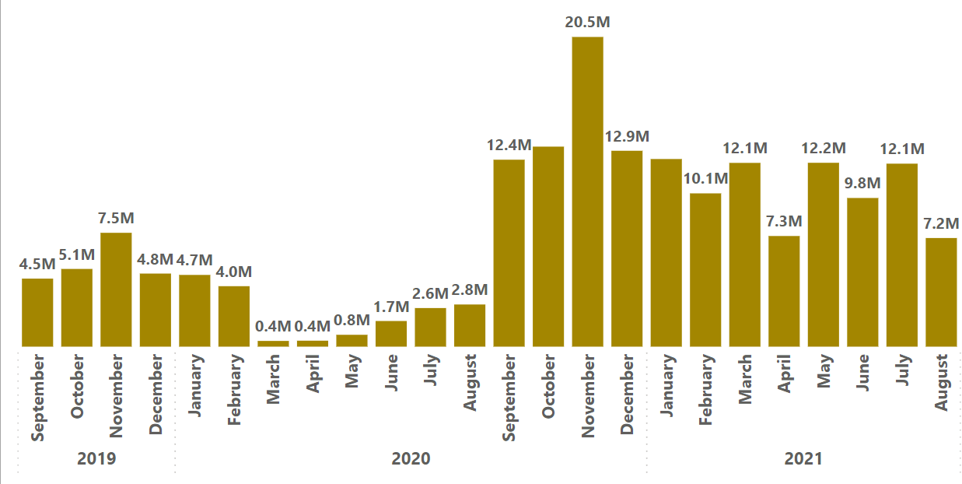


The gross sales was low during the period of March to August in 2020, the lowest ever being in March 2020.
However in the same year the gross sales went up from September onwards. The gross sales was the maximum in November 2020.

Slide 19
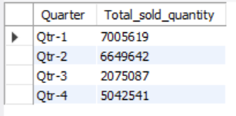
Request-8:
In which quarter of 2020, got the maximum total_sold_quantity?
SQL Query:
/*The fiscal year in Atliq starts from september 2019 */
with Qtr_table_2020 as(select date,fiscal_year, case
when date between "2019-09-01" and "2019-11-30" then "Qtr-1"
when date between "2019-12-01" and "2020-02-29" then "Qtr-2"
when date between "2020-03-01" and "2020-05-31" then "Qtr-3" when date between "2020-06-01" and "2020-08-31" then "Qtr-4" else null
end as Quarter,
sold_quantity
from fact_sales_monthly)
select Quarter, sum(sold_quantity) as Total_sold_quantity
from Qtr_table_2020
where fiscal_year=2020
group by Quarter;
Output:

Slide 20
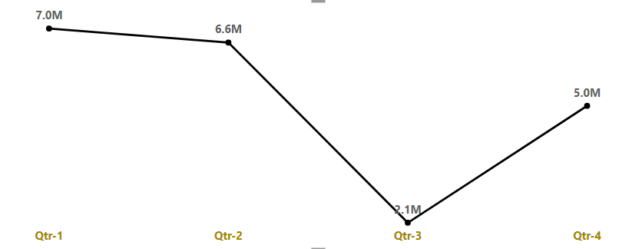
The maximum quantity was sold in the Quarter 1 in the fiscal year of 2020.

Slide 21
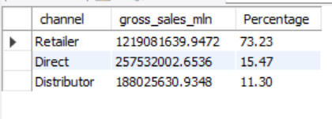
Request-9:
Which channel helped to bring more gross sales in the fiscal year 2021 and the percentage of contribution?
SQL Query:
select sum(sold_quantity*gross_price) into @Total_salefrom fact_sales_monthlyinner joinfact_gross_priceusing(product_code,fiscal_year)where fiscal_year=2021;
select channel, sum(sold_quantity*gross_price) as gross_sales_mln,
round((sum(sold_quantity*gross_price))/@Total_sale *100,2) as Percentage from dim_customer inner join fact_sales_monthly using(customer_code)
inner join
fact_gross_price
using(product_code,fiscal_year)
where fiscal_year=2021
group by channel
order by 2 desc;
Output:

Slide 22
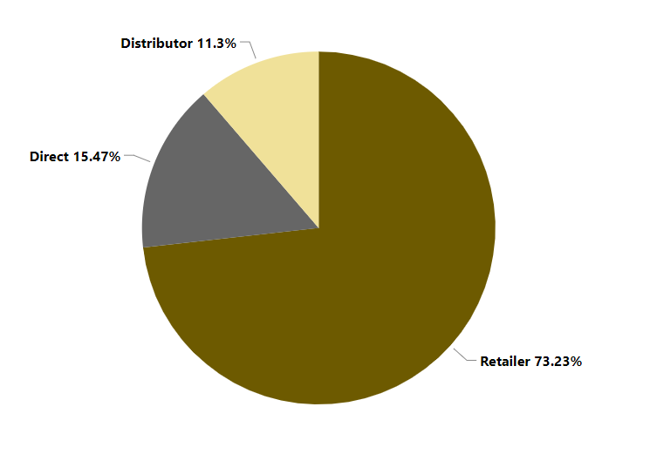
Retailers helped to bring more gross sales in the fiscal year 2021

Slide 23
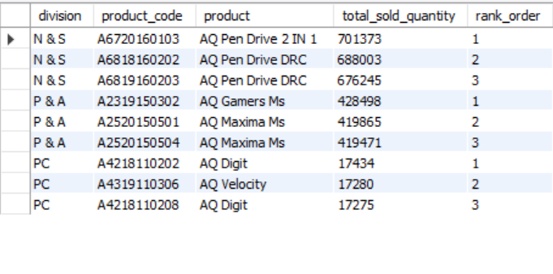
Request-10:
Get the Top 3 products in each division that have a high total_sold_quantity in the fiscal_year 2021?
SQL Query:
With Product_Sales as(with Product_Sales_Quntity
As
(select division, product_code, product, sum(sold_quantity) as total_sold_quantity
from dim_product inner join fact_sales_monthly using(product_code)
where fiscal_year=2021
group by product_code )
select *, dense_rank() over (partition by division order by total_sold_quantity desc)as rank_order from Product_Sales_Quntity)
select * from Product_Sales where rank_order<4;
Output:

Slide 24
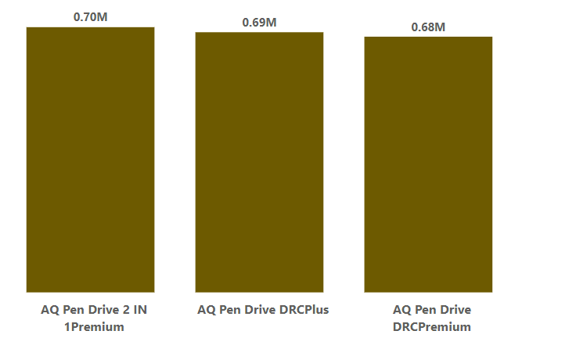
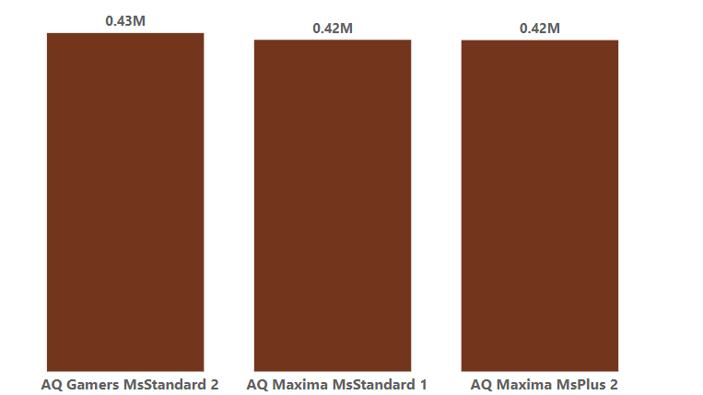
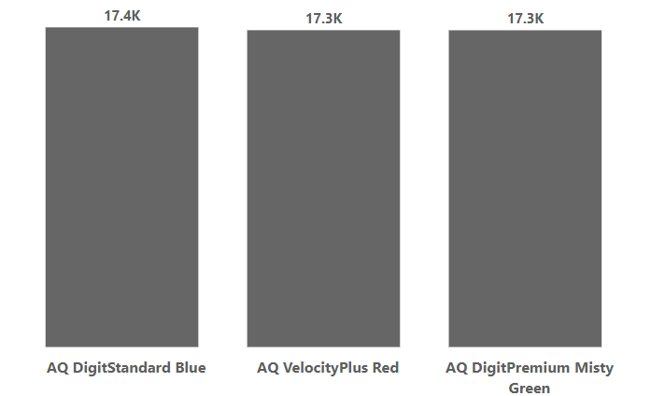
Top 3 Products
1.N &S Division: AQ Pendrive 2 in 1 Premium 2. P& A Division: AQ Gamers MS Standard 2 3.PC Division: AQ Digital Standard Blue
AQ Pendrive DRC Plus AQ Maxima Ms Standard 1 AQ VelocityPlus Red
AQ Pendrive DRC Premium AQ Maxima MsPlus 2 AQ DigitPremium Misty Green
N &S
P & A
PC

Slide 25
Thank You

